Slide 1
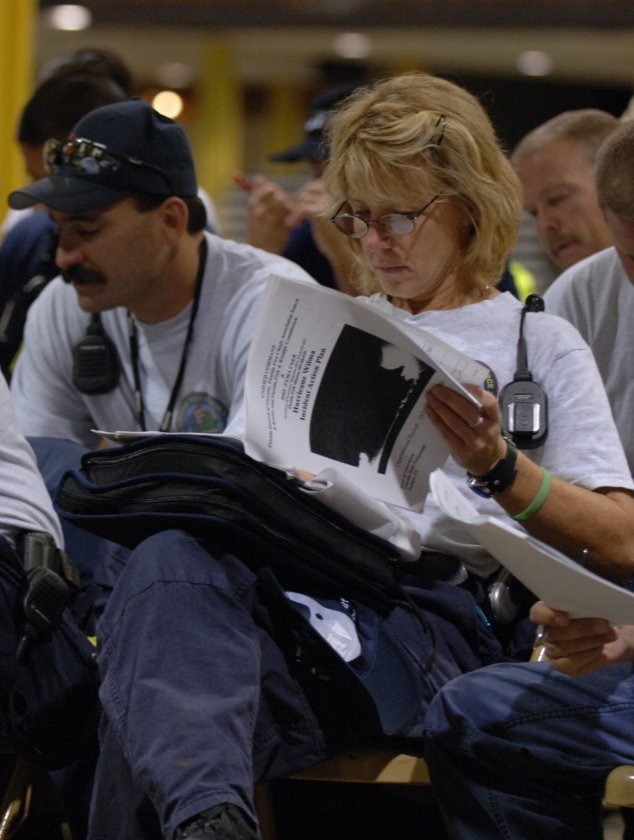
Unit 1:
Course Overview

Slide 2
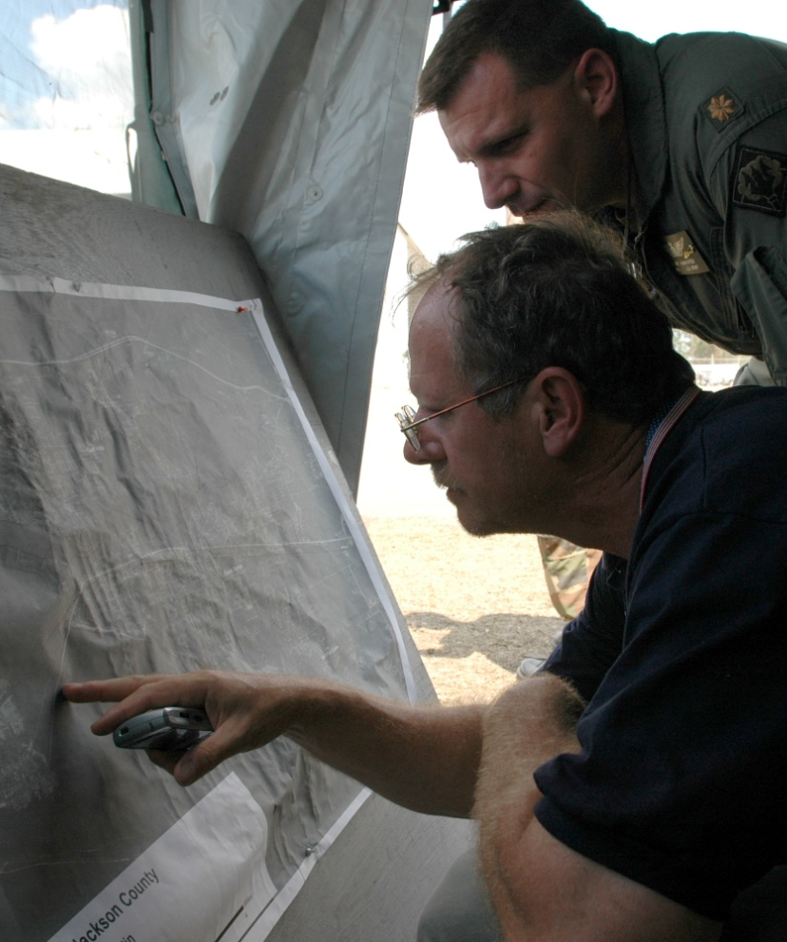
Course Goals
Demonstrate basic knowledge of the Incident Command System (ICS).
Be prepared to coordinate with response partners from all levels of government and the private sector.

Slide 3
Overall Course Objectives
After completion of this course, you should be familiar with ICS:
Applications.
Organizational principles and elements.
Positions and responsibilities.
Facilities and functions.
Planning.

Slide 4
Participant Introductions
Please provide your:
Name.
Job title.
Overall experience with emergency response.
Possible role in responding to incidents.

Slide 5
Participant Expectations
What do you expect to gain from this course?

Slide 6
Instructor Expectations
Cooperate with the group.
Be open minded to new ideas.
Participate actively in all of the training activities and exercises.
Return to class at the stated time.
Use what you learn in the course to perform effectively within an ICS organization.

Slide 7
Course Structure

Slide 8
Course Logistics
Course agenda
Sign-in sheet
Housekeeping:
Breaks
Message and telephone location
Cell phone policy
Facilities
Other concerns

Slide 9
Successful Course Completion
Participate in unit activities/exercises.
Achieve 75% or higher on the final exam.
Complete the end-of-course evaluation.

