Slide 1
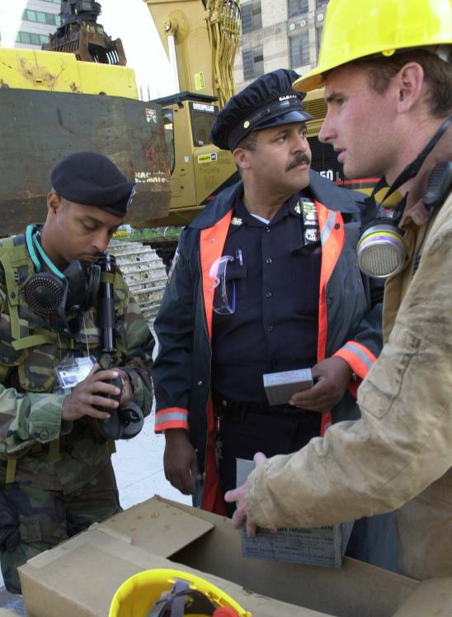
Unit 2:
ICS Overview

Slide 2
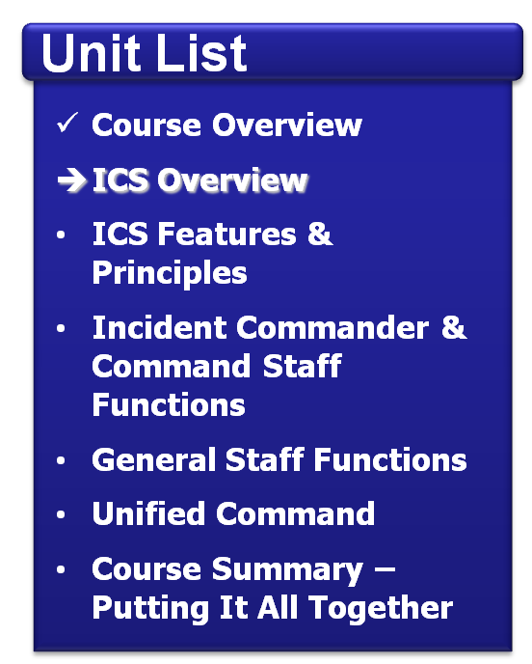
Unit Objectives
Identify:
Three purposes of ICS.
Requirements to use ICS.

Slide 3
Click on the image to start the video.

Slide 4
What Is ICS?
ICS:
Is a standardized, on-scene, all-hazards incident management concept.
Enables a coordinated response among various jurisdictions and agencies.
Establishes common processes for planning and management of resources.
Allows for integration within a common organizational structure.

Slide 5
When Is ICS Used?
ICS can be used to manage:
Natural hazards.
Technological hazards.
Human-caused hazards.
Planned events.

Slide 6
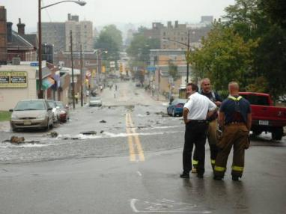
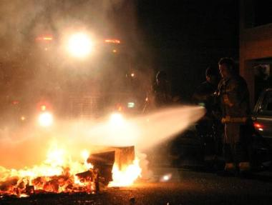
What Is an Incident?
An incident is . . .
. . . an occurrence or event, natural or human-caused, that requires a response to protect life or property.

Slide 7
Activity: ICS & Planned Events
Instructions: Working as a team . . .
Briefly describe one example where ICS could be used to manage a planned event (e.g., sporting event).
Identify the benefits of using ICS for the selected event.
Select a spokesperson. Be prepared to present your example in 5 minutes.

Slide 8
Why Use ICS?
1. It Works!
2. Mandates

Slide 9
National Incident Management System (NIMS)
What ? . . . NIMS provides a consistent nationwide template . . .
Who? . . . to enable Federal, State, tribal, and local governments, the private sector, and nongovernmental organizations to work together . . .
How? . . . to prepare for, prevent, respond to, recover from, and mitigate the effects of incidents regardless of cause, size, location, or complexity . . .
Why? . . . in order to reduce the loss of life and property, and harm to the environment.

Slide 10
NIMS Components & ICS
Preparedness
Communications and Information Management
Incident Command System
Resource Management
Multiagency Coordination Systems
Command and Management
Ongoing Management and Maintenance
Public Information
Additional Information: www.fema.gov/emergency/nims

Slide 11
Discussion Question
What are common causes of incident response problems?

Slide 12
Lessons Learned
Without ICS, incident responses typically:
Lack accountability.
Have poor communications.
Use unsystematic planning processes.
Are unable to efficiently integrate responders.

Slide 13
ICS Benefits
ICS helps to ensure:
The safety of responders, workers, and others.
The achievement of response objectives.
The efficient use of resources.

Slide 14
Activity: Management Challenges
Instructions: Working as a team . . .
Review the scenario presented in your Student Manuals.
Identify the top three challenges in managing this incident. Write these challenges on chart paper.
Using what you have learned so far, describe how ICS could be used to address these challenges.
Select a spokesperson. Be prepared to present in 10 minutes.

Slide 15
Summary
ICS:
Is a standardized management tool for meeting the demands of small or large emergency and nonemergency situations.
Represents best practices, and has become the standard for emergency management across the country.
May be used for planned events, natural disasters, and acts of terrorism.
Is a key feature of NIMS.

