Slide 1
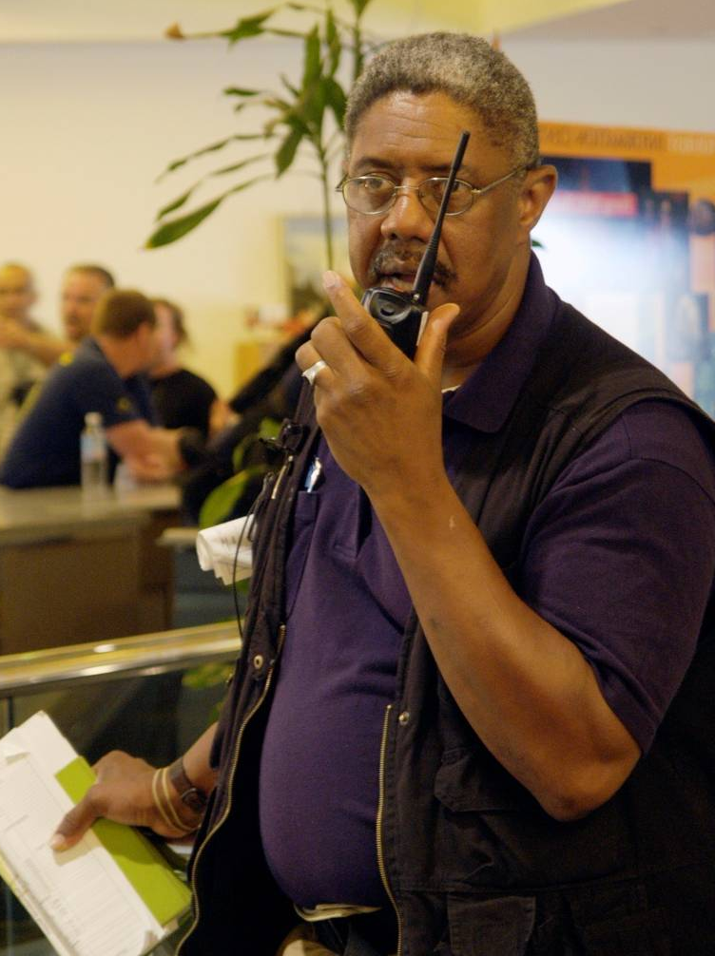
Unit 4:
Incident Commander and Command Staff Functions

Slide 2
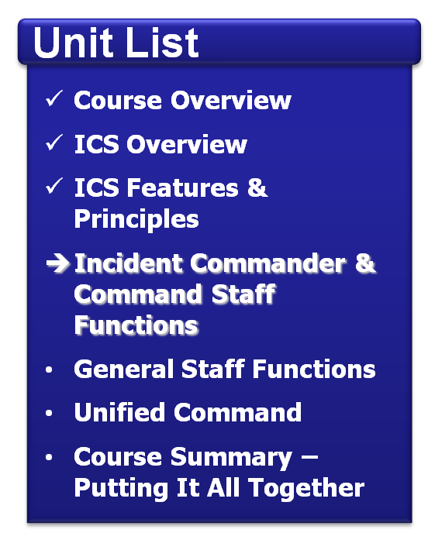
Unit Objectives
Identify the five major ICS management functions.
Identify the position titles associated with the Command Staff.
Describe the role and function of the Incident Commander.
Describe the role and function of the Command Staff.

Slide 3
Management Function Descriptions
Function | Description
Incident Command | Establishes incident objectives, strategies, and priorities. Assume overall responsibility for the incident.
Operations | Determines tactics and resources for achieving objectives. Directs the tactical response.
Planning | Collects and analyzes information. Tracks resources. Maintains documentation.
Logistics | Provides resources and needed services.
Finance/ Administration | Accounts for expenditures, claims, and compensation. Procures needed resources.

Slide 4
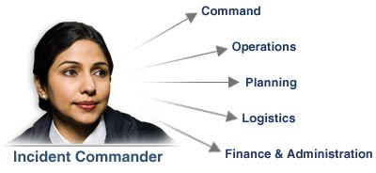
Incident Commander
The Incident Commander is responsible for all ICS management functions until delegated.

Slide 5
Discussion Question
Why is it critical to establish command from the beginning of an incident?

Slide 6
Delegating Incident Management Functions
Incident
Command
Operations
Section
Planning
Section
Logistics
Section
Finance/Admin
Section
Remember: The Incident Commander only creates those Sections that are needed. If a Section is not staffed, the Incident Commander will personally manage those functions.

Slide 7
Incident Commander Responsibilities
The Incident Commander is responsible for:
Ensuring incident safety.
Providing information to internal and external stakeholders.
Establishing and maintaining liaison with other agencies participating in the incident.

Slide 8
Discussion Question
Who has overall responsibility at an incident scene?

Slide 9
Deputy Incident Commander
A Deputy Incident Commander may be designated to:
Perform specific tasks as requested by the Incident Commander.
Perform the incident command function in a relief capacity.
Represent an assisting agency that shares jurisdiction.

Slide 10
Discussion Question
What needs to occur before the Deputy Incident Commander assumes control?

Slide 11
Expanding the Organization
Incident
Command
Command Staff: Provide information, safety, and liaison services for the entire organization.
Public Information
Officer
Safety
Officer
Liaison
Officer
General Staff: Delegated functional responsibilities.
Operations
Section
Planning
Section
Logistics
Section
Finance/Admin
Section

Slide 12
Click on the image to start the video.

Slide 13
Public Information Officer (PIO)
Incident
Command
The Public Information Officer:
Advises the Incident Commander on information dissemination and media relations.
Obtains information from and provides information to the Planning Section, the community, and the media.
Public Information
Officer
Safety
Officer
Liaison
Officer
The Incident Commander approves information that the PIO releases.

Slide 14
Safety Officer
Incident
Command
The Safety Officer:
Advises the Incident Commander on issues regarding incident safety.
Works with Operations to ensure safety of field personnel.
Ensures safety of all incident personnel.
Public Information
Officer
Safety
Officer
Liaison
Officer

Slide 15
Liaison Officer
Incident
Command
The Liaison Officer:
Assists the Incident Commander by serving as point of contact for representatives from other response organizations.
Provides briefings to and answers questions from supporting organizations.
Public Information
Officer
Safety
Officer
Liaison
Officer

Slide 16
Discussion Question
Who within your organization is qualified to serve as Command Staff?

Slide 17
Activity: Command Staff Roles
Instructions: Working as a team . . .
Review the case study presented in your Student Manual.
Identify which Command Staff positions would be assigned.
Next, determine what specific activities the Incident Commander would delegate to each Command Staff member.
Select a spokesperson. Be prepared to present in 10 minutes.

Slide 18
Summary
Are you now able to:
Identify the five major ICS management functions?
Identify the position titles associated with the Command Staff?
Describe the role and function of the Incident Commander?
Describe the role and function of the Command Staff?

