Slide 1
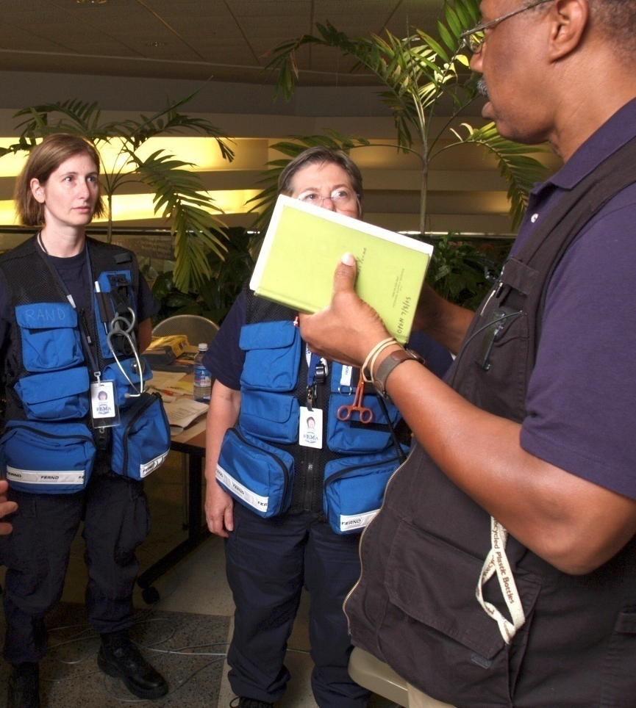
Unit 5:
General Staff
Functions

Slide 2
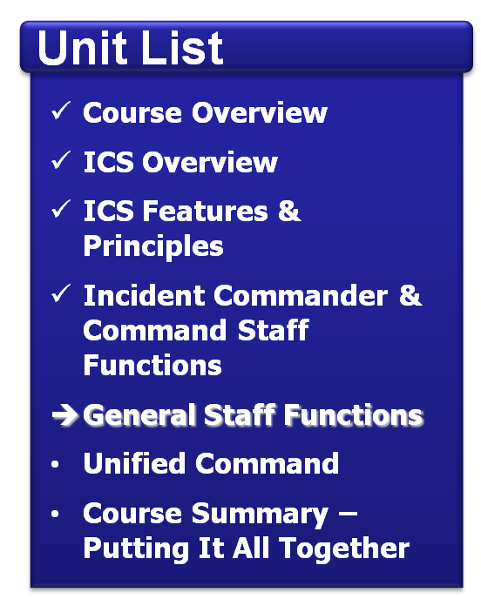
Unit Objective
Describe the roles and functions of the General Staff, including:
  Operations Section
  Planning Section
  Logistics Section
  Finance/Administration
  Section

Slide 3
General Staff Overview – Expanding Incidents
Incident
Command
Operations
Section
Planning
Section
Logistics
Section
Finance/Admin
Section
Directs all response/
tactical actions to achieve the incident objectives.
Activated, as needed, to support the incident response directed by the Operations Section.

Slide 4






Expanding Incidents
Expanding incidents may add supervisory layers to the organizational structure as needed.
Command
Incident Commander
Sections
Operations Section Chief
Branches
Units
Single Resources
Divisions
Groups

Slide 5
ICS Supervisory Position Titles
Organizational Level | Supervisor Title | Support Position Title
Incident Command | Incident Commander | Deputy
Command Staff | Officer | Assistant
General Staff (Section) | Chief | Deputy
Branch | Director | Deputy
Division/Group | Supervisor | N/A
Unit | Leader | Manager
Strike Team/Task Force | Leader | Single Resource Boss

Slide 6
ICS Section Chiefs and Deputies
  Section Chiefs may have one or more deputies.
  Deputies must be
  as proficient and qualified as the Section Chief.
Chief
Deputy
Deputy

Slide 7
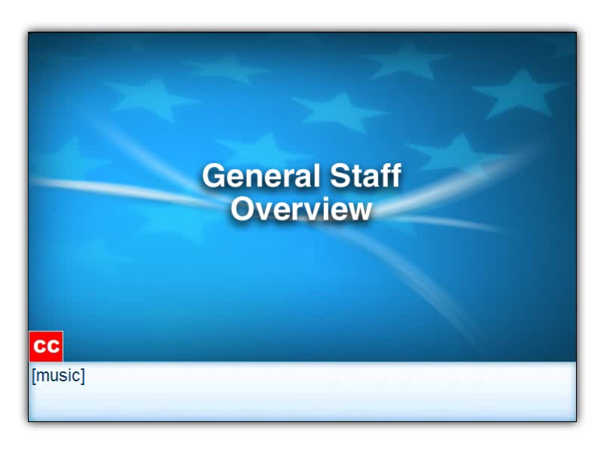
Click on the image to start the video.

Slide 8
Increasing Interagency Coordination
When an incident involves multiple organizations, assigning Deputies from other organizations can increase interagency coordination.
Incident
Commander
Operations
Section Chief
Deputy Operations
Section Chief

Slide 9
Operations Section: Major Activities
  Directs and coordinates all incident tactical operations.
  Is typically one of the first organizations to be assigned to the incident.
  Expands from the bottom up.
  Has the most incident resources.
  May have Staging Areas and special organizations.
Incident
Command
Operations
Section
Staging
Area
Rescue
Group
Investigation
Group

Slide 10
Operations: Single Resources
On a smaller incident, the Operations Section may be comprised of an Operations Section Chief and single resources.
Operations
Section Chief
Industrial
Hygienist
Facility
Engineer
IT
Specialist

Slide 11
Operations: Teams
Single resources may be organized into teams. Using standard ICS terminology, the two types of team configurations are:
  Task Forces, which are a combination of mixed resources with common communications supervised by a Leader.
  Strike Teams, which include all similar resources with common communications supervised by a Leader.

Slide 12
Sample Strike Teams and Task Forces
Operations
Section Chief
Search & Rescue
Strike Team
Medical Aid
Strike Team
Perimeter Security
Strike Team
Damage Assessment
Task Force
Shelter and Feeding
Task Force
Public Works
Task Force

Slide 13
Activity: Operations Section
Instructions: Working as a team . . .
  Review the scenario presented in the Student Manual.
  Develop an organization chart depicting how the Operations Section could be organized into teams.
  List the responsibilities of each team.
  Be prepared to present in 15 minutes.

Slide 14
Operations: Too Many Teams!
Additional levels of supervision must be added as the number of teams expands.
Operations
Section Chief
Shelter and Feeding
Task Force
Public Works
Task Force
Search & Rescue
Strike Team 1
Search & Rescue
Strike Team 2
Medical Aid
Strike Team 1
Medical Aid
Strike Team 2
Perimeter Security
Strike Team 1
Perimeter Security
Strike Team 2
Damage Assessment
Task Force 1
Damage Assessment
Task Force 2

Slide 15
The Solution: Add Functional Groups
Groups, led by a Supervisor, are used to perform functional areas of operation.
Operations
Section Chief
Response & Recovery
Group Supervisor
Perimeter Security
Group Supervisor
Emergency Services
Group Supervisor
Search & Rescue
Strike Team 1
Perimeter Security
Strike Team 1
Shelter and Feeding
Task Force
Search & Rescue
Strike Team 2
Perimeter Security
Strike Team 2
Medical Aid
Strike Team 1
Damage Assessment
Task Force
Medical Aid
Strike Team 2
Restoration/Recovery
Task Force

Slide 16
Geographic Divisions & Groups
Divisions, led by a Supervisor, are used to divide an incident geographically.
Operations
Section Chief
East Division
Supervisor
West Division
Supervisor
Recovery
Group Supervisor
Search & Rescue
Strike Team 1
Search & Rescue
Strike Team 2
Damage Assessment
Task Force
Perimeter Security
Strike Team 1
Perimeter Security
Strike Team 2
Restoration/Recovery
Task Force
Medical Aid
Strike Team 1
Medical Aid
Strike Team 2
Shelter and Feeding
Task Force 1
Shelter and Feeding
Task Force 2

Slide 17
Complex Incidents
Adding Branches helps to:
  Supervise Groups and Divisions.
  Further reduce span of control.
Operations
Section Chief
Emergency Response
Branch Director
Services
Branch Director
Search & Rescue
Group Supervisor
Evacuation
Group Supervisor
Medical Aid
Group Supervisor
Shelter & Feeding
Group Supervisor
Perimeter Security
Group Supervisor
Crisis Intervention
Group Supervisor

Slide 18
Activity: Organizing the Ops Section (1 of 3)
Instructions: Working individually . . .
  Review each scenario and organization chart presented in the Student Manual.
  Write the correct title missing from each organization chart.
  Be prepared to share your answers in 5 minutes.
Operations
Section Chief
Medical (EMS)
?
HazMat
?

Slide 19
Activity: Organizing the Ops Section (2 of 3)
Instructions: Working individually . . .
  Review each scenario and organization chart presented in the Student Manual.
  Write the correct title missing from each organization chart.
  Be prepared to share your answers in 5 minutes.
Operations
Section Chief
North
?
South
?

Slide 20
Activity: Organizing the Ops Section (3 of 3)
Instructions: Working individually . . .
  Review each scenario and organization chart presented in the Student Manual.
  Write the correct title missing from each organization chart.
  Be prepared to share your answers in 5 minutes.
Operations
Section Chief
Emergency
Services ?
Medical (EMS)
Group
HazMat Group

Slide 21
Planning Section: Major Activities
  Collecting, evaluating, and displaying incident intelligence and information.
  Preparing and documenting Incident Action Plans.
  Tracking resources assigned to the incident.
  Maintaining incident documentation.
  Developing plans for demobilization.
Incident
Command
Operations
Section
Planning
Section
Logistics
Section
Finance/Admin
Section

Slide 22
Planning Section: Units
Planning Section
Resources
Unit
Situation
Unit
Documentation
Unit
Demobilization
Unit
Technical
Specialists

Slide 23
Activity: Planning Section Units
Instructions: Working individually . . .
  Review the Planning Section chart in your Student Manual.
  Determine which of the Units would:
    Maintain a record of actions taken during an incident.
    Provide a map of the incident area.
    Oversee check-in procedures.
  Be prepared to share your answers in 5 minutes.

Slide 24
Logistics Section: Major Activities
  Ordering, obtaining, maintaining, and accounting for essential personnel, equipment, and supplies.
  Providing communication planning and resources.
  Setting up food services for responders.
  Setting up and maintaining incident facilities.
  Providing support transportation.
  Providing medical services for injured personnel.
Incident
Command
Operations
Section
Planning
Section
Logistics
Section
Finance/Admin
Section

Slide 25
Logistics Section: Branches and Units
  The Logistics Section can be further staffed by two Branches and six Units.
  The titles of the Units are descriptive of their responsibilities.
Logistics Section
Service Branch
Support Branch
Communications
Unit
Supply
Unit
Medical
Unit
Facilities
Unit
Food
Unit
Ground Support
Unit

Slide 26
Finance/Administration Section: Major Activities
The Finance/Administration Section is responsible for:
  Contract negotiation and monitoring.
  Timekeeping.
  Cost analysis.
  Compensation for injury or damage to property.
  Documentation for reimbursement (e.g., under MOUs).
Incident
Command
Operations
Section
Planning
Section
Logistics
Section
Finance/Admin
Section

Slide 27
Finance/Administration Section: Units
Finance/Administration
Section
Procurement
Unit
Time
Unit
Cost
Unit
Compensation/
Claims Unit

Slide 28
Activity: Section Chiefs
Instructions: Working individually . . .
  Review the table of statements presented in the Student Manual.
  Identify the correct Section Chief for each statement.
  Be prepared to share your answers in
  5 minutes.

Slide 29
Activity: General Staff Functions
Instructions: Working as a team . . .
  Review the scenario presented in your Student Manual.
  Use what you’ve learned to answer the questions in each part of the activity. Write your answers on chart paper.
  When you’ve answered each set of questions, move on to the next page.
  Select a spokesperson. Be prepared to discuss your answers with the class in 15 minutes.

Slide 30
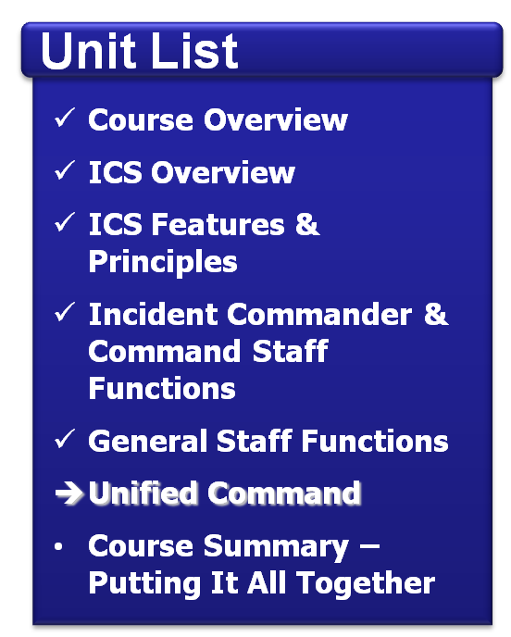
Summary
Are you able to describe the roles and functions
of the:
  Operations Section?
  Planning Section?
  Logistics Section?
  Finance/Administration
  Section?

