Slide 1
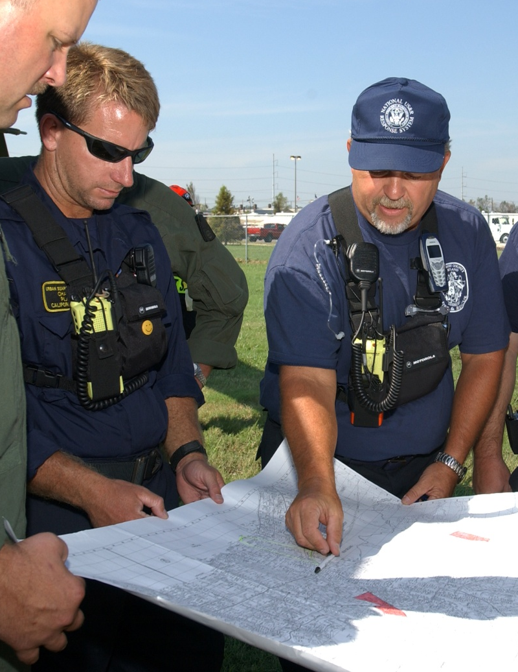
Unit 6:
Unified Command

Slide 2
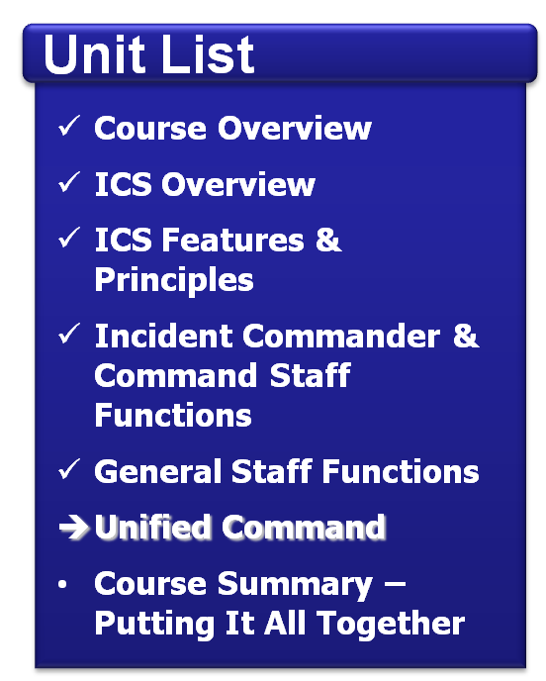
Unit Objectives
  Define Unified Command.
  List the advantages of
  Unified Command.
  Identify the primary features of Unified Command.
  Differentiate between command and coordination.

Slide 3
Activity: Optimal Strategy
Instructions: Working individually . . .
  Review the scenario presented in the Student Manual and select the optimal strategy that provides the best solution.
  Be prepared to share your answer in
  5 minutes.

Slide 4
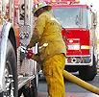
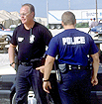
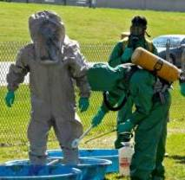


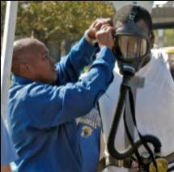
Unified Command
The Unified Command organization consists of the Incident Commanders from the various jurisdictions or organizations operating together to form a single command structure.
Fire & Rescue Incident Commander
Local Law Enforcement Incident
Commander
HazMat
Incident
Commander

Slide 5
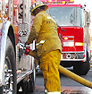
Unified Command Benefits
  A shared understanding of priorities and restrictions.
  A single set of incident objectives.
  Collaborative strategies.
  Improved internal and external
  information flow.
  Less duplication of efforts.
  Better resource utilization.

Slide 6


Unified Command Features
  A single integrated incident organization
  Co-located (shared) facilities
  One set of incident objectives, single planning process, and Incident Action Plan
  Integrated General Staff – Only one Operations Section
  Coordinated process for resource ordering

Slide 7
Possible Organization
Unified Command
HazMat Incident Law Enforcement Public Works
Commander Incident Commander Incident Commander
Unified Incident Objectives
Liaison Officer
Planning Section Chief
Logistics Section Chief
Finance/ Administration Section Chief
Operations Section Chief
Public Information Officer
Safety Officer

Slide 8
Discussion Question
What are potential barriers to implementing Unified Command?

Slide 9
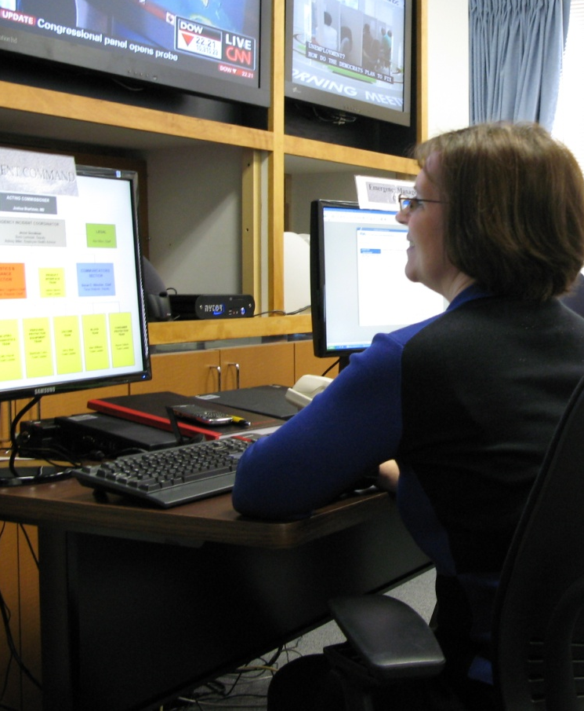
Making Unified Command Work
  Include key community response personnel.
  Make sure that first responders know their legal and ethical responsibilities.
  Learn ICS.
  Train and exercise together.

Slide 10
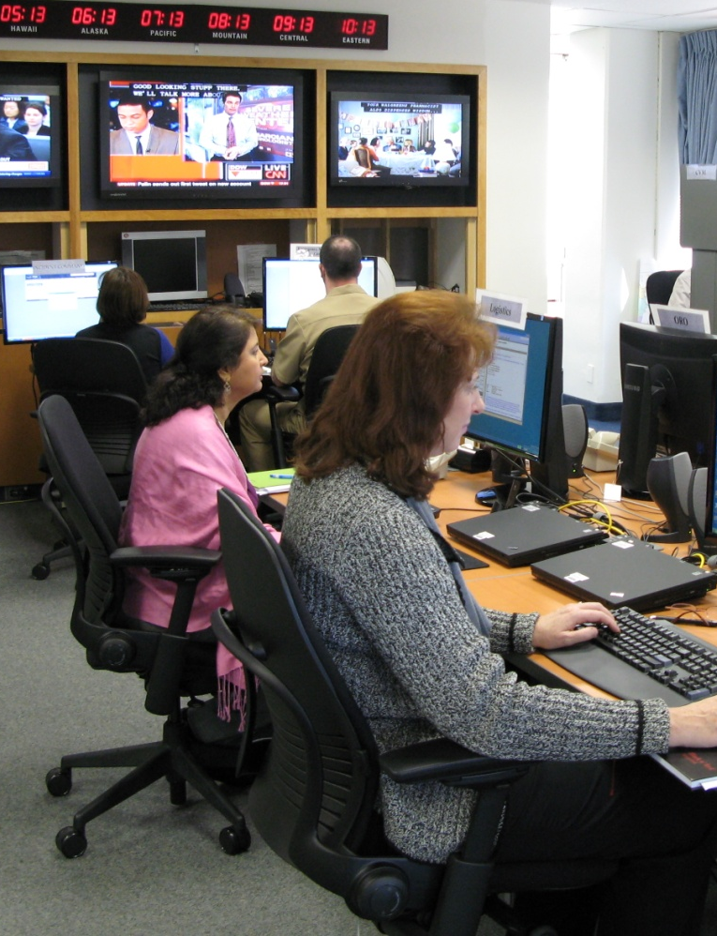
Incident Coordination
Coordination activities include:
  Establishing policy.
  Collecting information.
  Establishing priorities.
  Resolving resource issues.
  Facilitating support.
  Synchronizing public messages.

Slide 11

Joint Information Center
The Joint Information Center (JIC):
  May be established to coordinate public information activities.
  Serves as the central point of contact for all news media.

Slide 12
Activity: Unified Command
Instructions: Working as a team . . .
Review the scenario and questions presented in the Student Manual.
Refer to the quick-reference guides
in the Student Manual as needed.
Select a spokesperson and be prepared to present your work in
20 minutes.

Slide 13
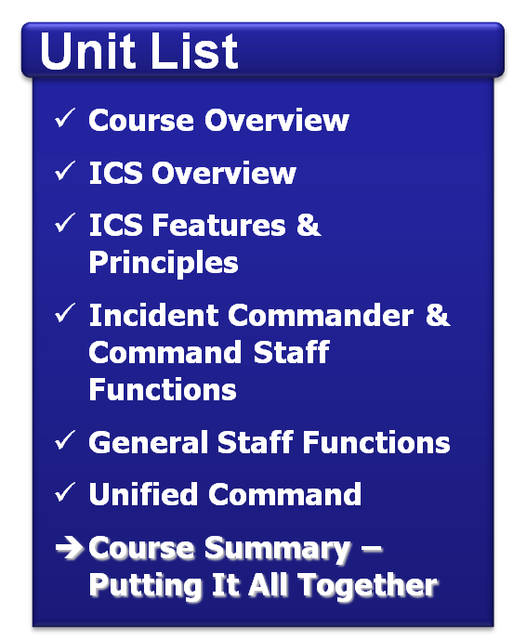
Summary
  Are you now able to:
  Define Unified Command?
  List the advantages of Unified Command?
  Identify the primary features of Unified Command?
  Differentiate between command and coordination?

