Slide 1
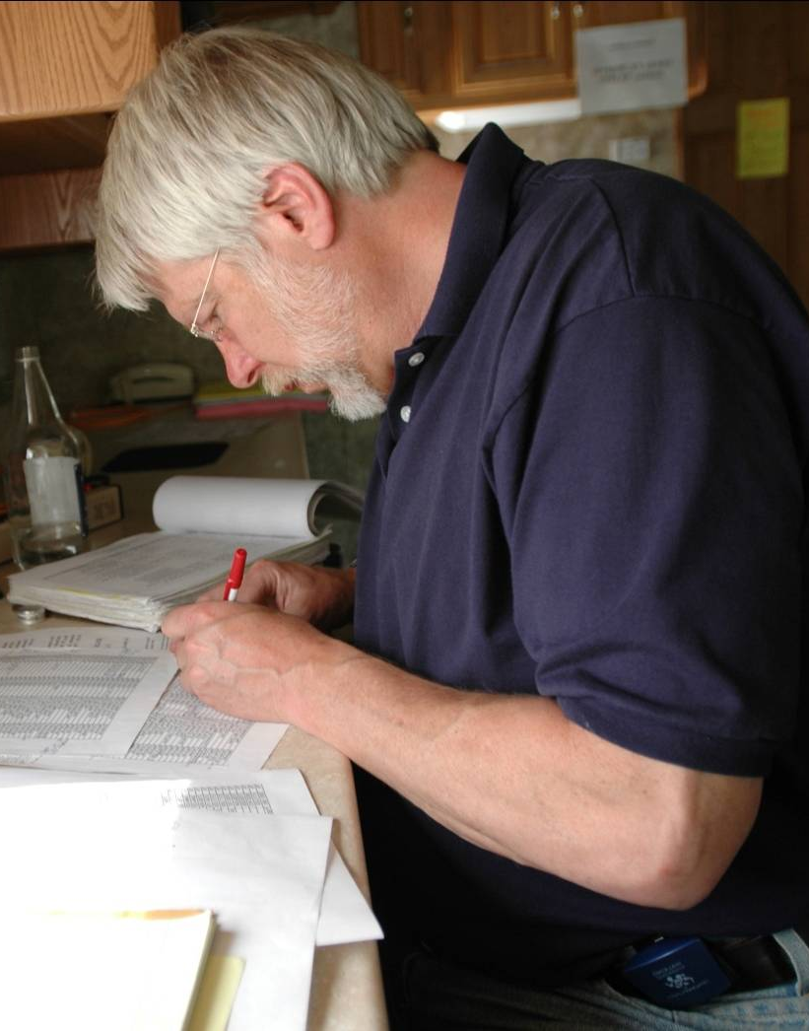
Unit 7:
Course Summary – Putting It All Together

Slide 2
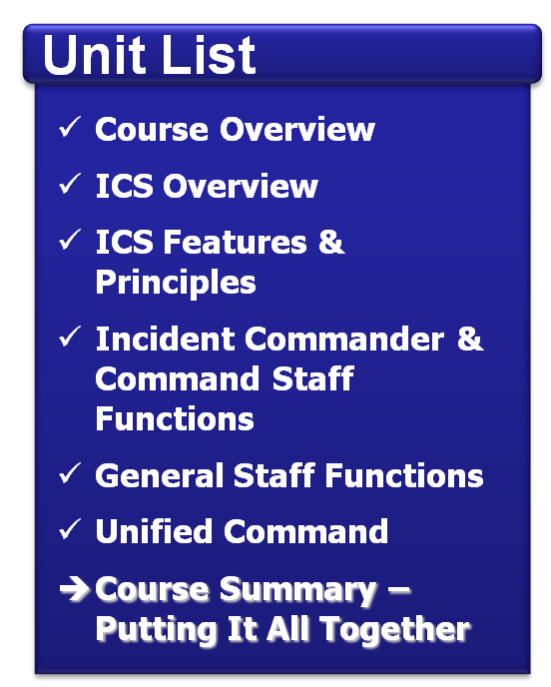
Unit Objectives
Describe the steps to take to ensure you are ready to assume ICS responsibilities.
Assess your organization's readiness for implementing ICS.
Take the final exam.

Slide 3
Assuming Accountability
ICS requires that you be accountable for:
Abiding by policies, procedures, and guidelines.
Working on objectives outlined in the Incident Action Plan.
Ensuring unity of command and chain of command by taking directions from your incident supervisor.
Managing your stress and being professional during the incident.

Slide 4
Dispatch/Deployment and Check-In
Do you know the procedures for:
Being dispatched/ deployed to an incident?
Checking in at the incident scene?

Slide 5
Initial Briefing
Briefings should include:
Situation assessment.
Job responsibilities.
Identification of coworkers.
Location of work area.
Identification of break areas.
Instructions for obtaining resources.
Operational periods.
Required safety procedures.

Slide 6
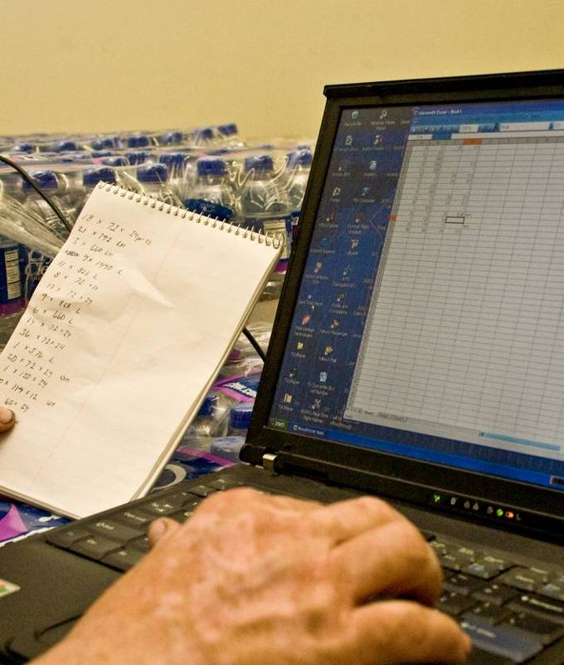
Recordkeeping
Print or type all entries.
Enter dates by month/day/year format.
Enter date and time on all forms and records. Use local time.
Fill in all blanks. Use N/A as appropriate.
Use military time.

Slide 7
Lengthy Assignments
Have you:
Assembled a go-kit?
Prepared personal items needed for your estimated length of stay?
Made arrangements to take care of your personal matters?

Slide 8
Demobilization
At the end of your assignment:
Complete all tasks and required forms/reports.
Brief replacements, subordinates, and supervisor.
Evaluate the performance of subordinates.
Follow check-out procedures.
Return any incident-issued equipment or other nonexpendable supplies.
Complete post-incident reports, critiques, evaluations, and medical followup.
Complete all time records or other accounting obligations.

Slide 9
Making ICS Work!
ICS works when everyone commits to:
Following the chain of command.
Reporting critical information.
Waiting to be dispatched.

Slide 10
Additional Resources
http://www.training.fema.gov/emiweb/IS/ICSResource

Slide 11
Taking the Exam
Instructions:
Take a few moments to review your Student Manual and identify any questions.
Make sure that you get all of your questions answered prior to beginning the final test.
When taking the test . . .
Read each item carefully.
Circle your answer on the test.
Check your work and enter the answers online.
You may refer to your Student Manual and the NIMS document when completing this test.

Slide 12
Feedback
Please complete the course evaluation form. Your comments are important!

