Slide 1
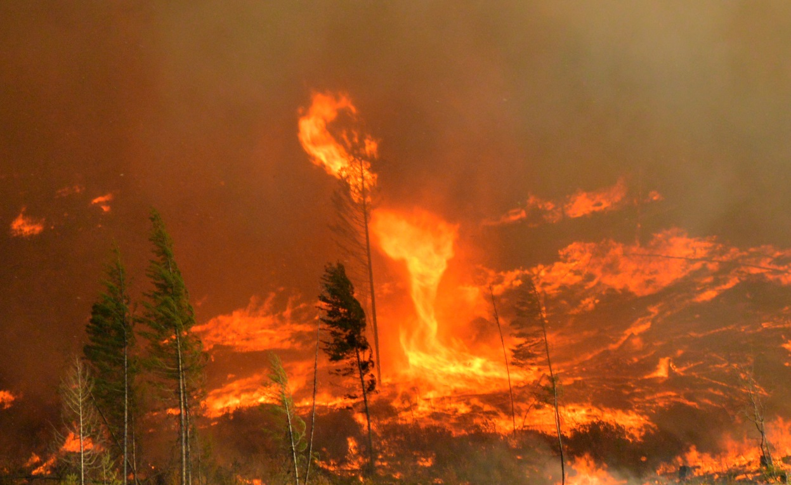
Stickpin Fire – Ferry County – August 2015
Mobilization Awareness Training

Slide 2
Course Outline
Mobilization Plan & Requests
Recommended/Required Training
Expectations of Responders
Mobilized Apparatus/Equipment
Command & Support Structure
Safety Aspects
Recordkeeping Systems & Procedures

Slide 3
Mobilization Plan & Requests –
The Mobilization Act was passed in 1992 by the State Legislature as a result of the Spokane Fire Storm.
The law was intended to:
Provide policy and organizational structure for large scale mobilization of firefighting resources (development of Mobilization Plan)
Provide a means for reimbursement to:
State agencies
Local fire jurisdictions that respond to incidents
Host fire department or fire protection district
The Plan is currently under revision however, the most recent published version is available for download at http://www.wsp.wa.gov/fire/mobilization.htm.
Notes:
State mobilization is a process used to quickly notify, assemble and deploy fire service personnel and equipment to any local fire jurisdiction in the state that has expended, or will expend, all available local and mutual aid resources in attempting to manage fires, disasters and other all-hazard events that threaten a community.
The first Mobilization Plan was completed weeks before the 1994 Chelan Fire Storm which burned 180,000 acres, caused the evacuation of 2,700 homes and ultimately destroyed 37 homes.
Commonly referred to as the Plan, it is a part of the State’s Comprehensive Emergency Management Plan (CEMP) under Emergency Support Function 4, Firefighting.

Slide 4
State Fire Defense Committee (FDC)
The Legislation also called for the creation of the Fire Defense Board, now the Fire Defense Committee, who was tasked with the development of the Mobilization Plan. They are responsible to:
Maintain the Mobilization Plan; develop procedures concerning fire service personnel deployment to and on Mobilization assignments.
Assist in locating and tracking fire service resources.
Recommend Rate Schedule for the Washington Fire Chiefs Association approval.
Notes:
Committee membership consists of:
Two representatives from each of the nine fire defense regions
Washington State Fire Marshal
Emergency Management Division
WA DNR – Resource Protection Division
Washington State Emergency Management Association

Slide 5
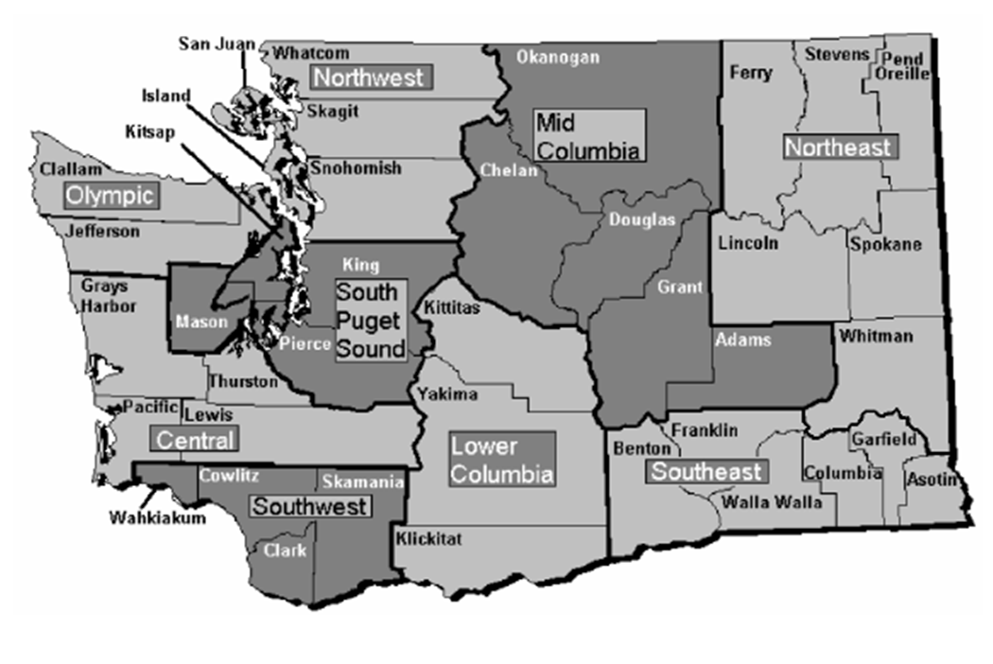
Fire Defense Regions

Slide 6
Regional Coordinators
There are two regional coordinators per region, a primary and an alternate. They are responsible to:
Maintain current Regional Fire Resource Lists.
Develop and maintain Regional Fire Defense Plans.
Provide a 24 hour point of contact for resource requests.
Assist local Fire Chiefs in submitting mobilization requests.
Notes:
Identify the regional and county coordinators for the region and provide necessary contact information.
Explain the Region’s mobilization plan and how that fits into the Plan.
Identify and explain the region’s mobilization procedure and identify potential primary and secondary staging areas, mobilization points and resource bases.

Slide 7
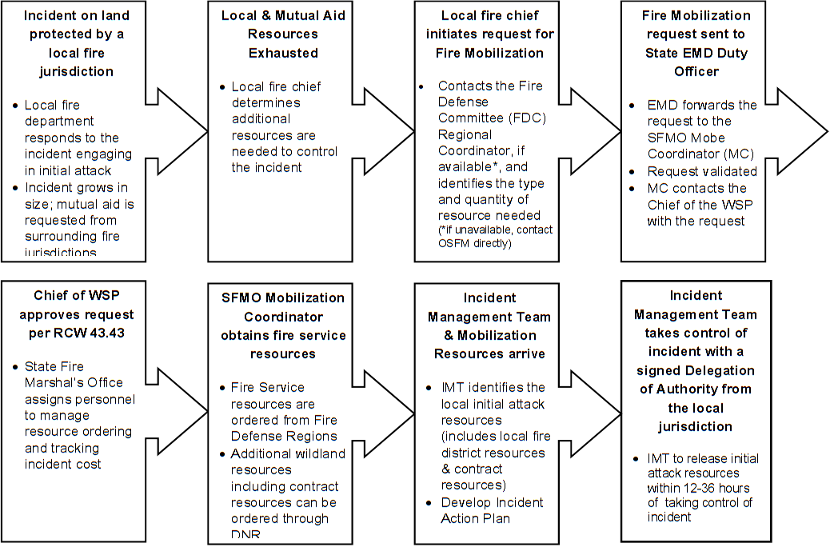
Fire Mobilization Authorization and Response Process
Notes:
Only the Fire Chief of the local fire protection jurisdiction or fire chief's authorized representative has the authority to request state fire services resource mobilization.
In most circumstances, a mobilization request is approved within 30 minutes of receipt by the SFMO. Approval of a Mobilization request is independent of DNR or federal agency response with the coordination of firefighting efforts through Unified Command.
Once approved – resource response is coordinated by the SFMO Mobilization Section, who order additional engines, air resources and other logistical support needed to control the incident.
SFMO personnel will respond to the incident and work as a liaison between the Incident Commander and Agency Administrator.

Slide 8
Recommended/Required Training –
Mobilization Awareness training is required for all personnel who may be called to respond to a state mobilization incident.
Wildland Response: At a minimum, line personnel shall meet all of the requirements and physical fitness qualifications for the position of NWCG Firefighter 2 or as specified in WAC 296-305-07010 and have completed the annual refresher and fire shelter training. Overhead positions must meet requirements as set forth in PMS 310-1 for the position they are ordered for unless otherwise authorized by the Plan.
Type 3 Incident Management Team members must be qualified in accordance with Section 10 of the Plan.
Notes:
Personnel responding to a land management agency request for overhead positions shall meet the training requirements established for the ICS position filled.
A Strike Team/Task Force Leader trainee may be requested/assigned as a member of the unit. Personnel filling the trainee position shall be certified at the Strike Team/Task Force Leader trainee level per NWCG 310-1.
Field training opportunities may be available for individuals that possess a task book, initiated by their home agency. To get the most out of your assignment: discuss your training needs with your supervisor early in the incident and check in with the incident training specialist.
If you are requesting a change in assignment, i.e., SRB on an engine to an open STL-t spot, you MUST notify and receive approval from the Mobe rep as a new resource order number will need to be assigned to you.
Limits of Activity:
Permitted activities on a Mobe will be based upon current training, experience and physical conditioning levels.
Personnel have the responsibility to turn down an assignment that exceeds their training and/or experience level.

Slide 9
Expectations of Responders –
Incident Conduct
Resources mobilized to an incident shall adhere to the SFMO Code of Conduct.
All personnel participating in a mobilized incident will abide by all federal and state laws prohibiting any form of discrimination or harassment.
Mobilized resources are required to follow their home agency’s policies and work rules.
The unlawful manufacture, distribution, dispensing, possession, or use of controlled substances (including alcoholic beverages) in the workplace or assigned workplace is prohibited.
The decision whether to demobilize personnel for allegations of misconduct will reside with the Incident Commander in consultation with the SFMO.
Notes:
Entire Code of Conduct is in Section 12 of the Plan.
(Section 12)

Slide 10
Length of Assignment
Initial Attack and Immediate Need resources are usually released within 12-36 hours.
Minimum time commitment of 72 hours.
Crew changes require 24 hour advanced notice and must be approved by the Strike Team Leader.
Resources are expected to be self-sufficient for up to 24 hours depending on the conditions of the incident.
Notes:
When accepting a dispatch to a Mobilization, resources are required to stay until demobilized. An agency may replace a crew after 72 hours assigned to an incident. Although mobe incidents tend to be short in duration, there are incidents that extend beyond 14 days. Mobe resources DO NOT adhere to the Federal or DNR rules and regulations regarding length of assignment or R&R days.
Notice of intended crew changes must be provided a minimum of 24 hours in advance. A completed Mobilization Manifest shall be submitted for the incoming resource(s). Crew change requests/notifications must be made through the incident chain of command and to the Mobilization Representative at the incident. Crew changes must be coordinated to occur during unassigned incident time.
Crew changes involve the people NOT the apparatus. Apparatus changes are not allowed without pre-authorization of the mobilization representative.
There are limitations on reimbursement of costs incurred in making crew changes.
(Section 7 & 16)
Per Diem & Accommodations
Resources are expected to be self-sufficient for up to 24 hours depending on the conditions of the incident. After 24 hours, resources may submit per diem claims only for those meals that are not available at camp.
Established camp accommodations for housing, feeding, and support of state mobilized personnel shall be used when provided. Alternate accommodations may be utilized at the expense of the user. The costs for alternative accommodations are not reimbursable.
(Section 18)

Slide 11
Travel Kit
Required for a wildland assignment:
Fire shelter (new generation)
Flame resistant clothing (shirt and trousers)
Helmet with chinstrap and headlight clips
Eye protection
Leather boots (8” lace up)
Small backpack or web gear for working on the fireline
Watch
Notes:
For interface operations, FFs will need complete structural PPE in addition to the items above.
See Appendix K of the Plan for a complete list of items to include in your kit. This is not a vacation. DO NOT bring lawn chairs, hammocks, electronics, etc.
Personal Hygiene and Care:
Shower facilities may not be immediately available for personnel.
When available, please use them.
Wash your hands before each meal.
Stay hydrated – avoid caffeinated beverages.

Slide 12
Social Media
Mobilized personnel must follow both home agency guidelines and IMT directions regarding the use of social media.
Remember social media can:
Generate destructive rumors amongst the affected population.
Expose the responder to legal risk.
Facilitate the unauthorized release of information before affected parties have been contacted by authorities.
Notes:
No one wants to find out their home burned via Twitter or Facebook!

Slide 13
Mobilized Apparatus/Equipment –
Typing
Apparatus typing is established by NWCG.
Resource Configuration
Single Resource
Strike Team
Task Force
Contract Engines
One contract engine may be assigned to each strike team.
Contract engines will meet the strike teams at the incident.
Contract engines complete only an equipment shift ticket, CTRs are not required for personnel.
Contract engine request numbers will be separate from the strike teams.
Notes:
Rate Schedule has tables showing the typing requirements for each type of apparatus.
Resource configurations are listed in Section 13.
Single resources, i.e., dozers, air, etc, are usually ordered through the DNR as they are not typically available through the fire service.
Mobilization resources are typically sent as a wildland task force – 5 wildland engines, 1 tender, 1 STL, 1 STL-t.
For all mobilization incidents where Extended Attack or Planned Need engine strike teams are ordered, an order for contract engines will be placed. The contract engine orders may or may not be filled, regardless the strike team will still be dispatched.

Slide 14
Command & Support Structure –
The SFMO will assign an appropriate level of incident management to each mobilization incident.
All responding fire service resources should be trained to the ICS-100 level at a minimum.
Span of control for any supervisor is considered 3-7 subordinates and optimally does not exceed 5.
Notes:
ICS – The State of Washington has adopted the National Incident Management System (NIMS) and will use the Incident Command System (ICS) to manage all incidents involving State Mobilization resources. This section is not intended to provide a comprehensive review of ICS and assumes responder familiarity w/the system.
IMT – State mobilization may be under the command of a Type 1, 2 or 3 IMT or unified command w/a local IC and a Type 1-4 IC.
Span of control – To maintain span of control, responders are organized into Strike Teams and Task Forces, each with a leader and common communications.
Follow chain of command

Slide 15
IMT Sections/Positions
Command & General Staff
IC
PIO
SOF
LOFR
Finance/Administration Section
Time Unit
Procurement Unit
Compensation/Claims Unit
Planning Section
Resource Unit
Situation Unit
Documentation Unit
Notes:
IC – Responsible for all aspects of the response, including developing incident objectives and managing all incident operations. Generally, resources will have no direct operational contact w/the IC, use the chain of command.
PIO – Responsible for the development and release of incident information. Notify the PIO of any community concerns. Direct all media to the PIO unless otherwise directed.
SOF – Responsible for incident safety. Must be notified of injury or vehicle damage, communicate through your STL.
LOFR – Point of contact for assisting cooperating agencies. Direct inquiries from outside agencies to the LOFR.
Finance – Responsible for all financial and cost analysis aspects of the incident.
Time Unit – Tracks personnel and equipment time. Turn in CTRs and shift tickets daily!!!
Procurement Unit – Manages the procurement and buying needs of the incident. This position is not typically filled on a Type 3 incident.
Compensation/Claims Unit – Responsible for all administrative matters pertaining to compensation for injury and claims related to the incident. On a mobilization, you will typically discuss these items directly w/the Mobe rep. This position is not typically filled on a Type 3 incident.
Planning Section – Responsible for the collection, evaluation, dissemination and use of incident information and the status of resources.
Resource Unit – Advise if unit is out of service.
Situation Unit – Provide w/GPS tracks and lists of notable damage w/in the incident, i.e., destroyed homes.
Documentation Unit – Turn in ICS 214 Unit Logs and personnel evaluations.

Slide 16
IMT Sections/Positions
Logistics Section
Communications Unit
Medical Unit
Supply Unit
Facilities Unit
Ground Support Unit
Operations Section
Branches
Air Operations Branch
Divisions/Groups
Notes:
Logistics – Responsible for providing facilities, services and materials for the incident response.
Communications Unit – Provides incident communications. The comm unit can provide portable radios and batteries. See the comm unit if you a problem w/your radio equipment.
Medical Unit – Responsible for the development of the Medical Plan and the provision of medical care for incident response personnel. Can assist w/medical needs and must be notified of medical emergencies involving incident personnel.
Supply Unit – Responsible for providing equipment and supplies needed to support the incident. See the supply unit to procure equipment and supplies such as replacement hose, nozzles and fittings. In most cases, items checked out from the supply unit, must be returned. Items that are not returned will have the replacement cost deducted from the agency reimbursement for the apparatus. In some cases, reimbursement to the agency will be held until the item(s) is/are returned.
Facilities Unit – Responsible for incident facilities.
Ground Support Unit – Responsible for incident transport needs. Conducts vehicle inspections and may be able to assist w/minor mechanical repairs.
Operations Section – Manages and supervises the operational aspects of the incident operation. Interface w/in the ops section in accordance w/chain of command.
Branches – Can be used to divide an incident geographically or functionally, typically used when necessary to manage span of control.
Air Ops Branch – Responsible for all air operations in the incident. Air resources w/in your area of operation are normally requested through the DIVS.
Divisions – Used to divide an incident geographically. Only the STL/TFL should communicate directly to the DIVS, except in an emergency where the STL/TFL cannot be reached.
Groups – Used to divide the incident by function.

Slide 17
Mobilization Representative
Acts as a subject-matter expert on the Plan.
Serves as WSP Agency Representative and Mobilization Incident Business Advisor.
FDC Liaison
A current or past member of the Fire Defense Committee.
Serves as a liaison to the Fire Chief of the host agency and host Regional Coordinator.
Notes:
An employee of the WSP/SFMO is dispatched to each mobilization incident to act as the Mobilization Representative. The Mobe rep may assist in the finance section as well as acquiring facilities and supplies. Please familiarize yourself with Esther and Barbie, they are willing to answer any questions you have about Mobilization. They also process all of the reimbursements to personnel and agencies.
All requests for fire service resources must be approved by the Mobilization rep. They will issue all Mobilization resource order numbers.
The FDC liaison position may or may not be filled. When they are not dispatched to an incident, it is the responsibility of the Mobe rep to act as a liaison to the host agency.

Slide 18
Safety Aspects –
Operating Environment
Potentially dangerous conditions.
12+ hour shifts.
Camp-type sleeping, eating and showering.
Potential Dangers
Extreme fire behavior.
High temperatures and a smoke filled environment.
Limited water supply.
Downed power lines.
LPG tanks and hazardous materials.
Falling trees, rolling rocks and logs.

Slide 19
Safety Precautions
Maintain LCES.
Adhere to the 10 Standard Fire Orders and 18 Watch Outs.
Manage fatigue.
Obtain a briefing.
In the wildland/urban interface:
Do not commit to stay and protect a structure unless a safety zone for firefighters and equipment has been identified and established.
Base all actions on current and expected fire behavior.
Estimate the approaching fire intensity to determine whether there is an adequate safety zone and time available before the fire arrives.
Primary consideration is for the safety of the responders and apparatus.
Notes:
Manage Fatigue – Get adequate rest and stay hydrated.
Obtain Briefing – Know who you are working for; understand your assignment; acknowledge messages; ask if you don’t know; only accept assignments commensurate w/your level of training and experience.

Slide 20
Safety Precautions
Driving Safety:
Remain aware of your surroundings.
Avoid excessive speed, especially on steep grades.
Headlights on for safety.
Increase following distance when traveling in a strike team.
Keep windshields clean.
Use emergency lights in heavy smoke or dust conditions.
Use a spotter when backing.
Do no drive through heavy smoke where you cannot see.
Use wheel chocks.

Slide 21
Accident & Injury Reporting
Vehicle accidents must immediately be reported to the Division/Group Supervisor and Safety Officer.
Injuries must immediately be reported to the Division/Group Supervisor who will in turn advise the Medical Unit.
Notes:
The SOF will investigate and document the accident.
The Medical Unit will provide or arrange for care of the injured person.
Documentation requirements will be covered in the next section…

Slide 22
Recordkeeping Systems & Procedures –
Incident Number
Sequential number assigned by SFMO to Mobilization, i.e., WA-WFS-xxx
Based off a national system.
Request Number
All ordered resources will receive a 4-digit request number.
The request number is the authority reference for all claims, including those of the personnel assigned to the units.
Ensure the request number is on all documentation including but not limited to CTRs, shift tickets, manifests, 288s, damage claims, etc.
Notes:
There will be multiple incident numbers assigned to a multijurisdictional incident, one for each jurisdictional agency.
First two letters indicate state, the next three letters indicate agency location.
Forest Service WA-**F-000
DNR WA-**S-000
Bureau of Indian Affairs WA-**A-000
Bureau of Land Management WA-**D000
US Fish & Wildlife WA-**R-000
National Park Service WA-**P-000
You must receive this number prior to leaving for the incident.
The SFMO will issue all request numbers.
Strike team request numbers will be consecutive, i.e., 2101 STL, 2102-2106 Engines, 2107 Tender, 2108 STL-t.
O – Overhead
E – Equipment
A – Aircraft
C – Crews
S – Supplies

Slide 23
Forms
Manifest
Crew Time Report (CTR)
Emergency Firefighter Time Report (Red Dog)
Equipment Shift Ticket
Fuel/Oil Issue
Emergency Equipment Use Invoice
W-4
WSP Waiver of Polygraph and Background Check
W-9
Payee Registration
Notes:
Manifest – Used to record personnel and apparatus sent to an incident either as a single resource or as a strike team/task force. Complete one form per apparatus and submit to Mobilization Section. Present manifest at check-in.
CTR – Used to track time of personnel. One form for each apparatus. Must be signed by DIVS.
Red Dog – Used to track firefighter time. Hours from CTR are transferred onto the red dog by the finance section.
Shift Ticket – Used to track equipment time. Signed by the ENGB and the DIVS. Indicate type of apparatus, license number and unit identifier, i.e., B-211. On the initial travel day, keep track of both miles driven and hours worked. Command vehicles are reimbursed for MILEAGE, not hours worked.
Use Invoice – Used to track equipment time. Hours from shift ticket are transferred onto use invoice by the finance section. Indicate type of apparatus, license number and unit identifier, i.e., B-211.
A current W-4 and WSP Waiver (rev 5/12) must be completed by volunteer personnel that will be reimbursed by the WSP. Please indicate your MAILING address.
A W-9 and payee registration form must be completed by personnel who are using a POV.

Slide 24
Check-In
All personnel must check-in at the incident.
Be prepared to provide the following:
Manifest
Emergency Equipment Use Invoice
Equipment Shift Ticket
Emergency Firefighter Time Report
CTR
WSP Waiver & W-4 (volunteers only)
Qualification Card
Timekeeping
Ensure all CTRs and shift tickets are complete, accurate and signed by a Division/Group Supervisor.
Turn in CTRs and shift tickets at the end of each shift.
Notes:
Each IMT does check-in a bit differently. Ensure you have all of the above forms completed and ready to turn in. A mobe rep will usually be on-scene to assist with any questions or issues however, if there a multiple ongoing mobilizations, a Mobe rep may not be available. If the IMT does not take your forms and asks you only to complete the Check-in form, keep your forms in a safe location as they may ask for them later.
Dropping off CTRs and shift tickets is a good time to touch bases with Finance and/or Mobe rep to find out if there are any issues with your paperwork…
STLs should be collecting all books and verifying hours prior to DIVS signature. All CTRs and shift tickets for strike team should be clipped together and submitted to finance.
Some IMTs will have different practices and procedures, i.e., Team 3.

Slide 25
Compensable vs Non-Compensable
Personnel
Travel time
Time in Assigned Status
Non-Compensable Time
Apparatus
Travel time
Compensable Time (On-Shift)
Non-Compensable Time
Wet Rate
Notes:
Personnel
Travel time: Calculated as the mileage from the home agency to incident divided by 45mph.
Time in assigned status: Assigned hours are those in which the employee is assigned to duty on the incident according to the shift plan. Lunch breaks are considered on-duty time, record on CTR as “1/2 hour compensable lunch”.
Non-compensable time: Time when an individual is not on assigned duty and is free to leave the area, i.e., unscheduled hours for meals (breakfast and dinner), time required for vehicle service or maintenance, out-of-service time, etc.
Discuss excessive travel, compensable meal breaks, briefings, out of service documentation, crew change travel, muster & rehab, staging/standby. (Section 16)
Apparatus
Compensable time (On-Shift): Specific work includes, but is not limited to, assigned suppression work, assigned staging, and assigned support activities.
Travel time: Calculated as the mileage from the home agency to incident divided by 45mph.
Non-compensable time: Unscheduled hours for meals (breakfast and dinner), time required for vehicle service or maintenance, out-of-service time, etc.
Wet rate: All apparatus and equipment are paid at a wet rate inclusive of all fuel, oil, maintenance, repair, insurance, and incidental cost, i.e., ferry toll.
Discuss hourly rate, mileage rate, muster/rehab, mechanical failure, fuel trucks. (Section 17)

Slide 26
Loss/Damage Report
A loss/damage report should be completed regardless if a claim for reimbursement will be filed.
The Safety Officer or DIVS should complete the investigation portion of the form.
Notes:
A Loss/Damage Report should be completed and submitted to the Mobe rep for documentation purposes even if the agency does not intend to submit a claim. This form and an investigation MUST be completed if the agency intends to request for reimbursement of the loss or damage. Submittal of the form does NOT guarantee reimbursement. All reimbursement requests are subject to review and approval.
If repairs are completed by incident personnel, i.e., a DNR mechanic, the cost of those repairs will be deducted from the reimbursement to the apparatus and will show as a deduction on the OF-286.
It is the STL responsibility to ensure the loss/damage and injury/exposure form is complete and submitted to the Mobilization Representative.
Loss/damage (Section 20)

Slide 27
Injury/Exposure Report
Any injury must be reported to the on-scene DIVS or higher officer so that the circumstances can be confirmed and a record made.
The injury/exposure report should be completed at the time of injury and notification made to the Mobilization Representative and home agency within 24 hours.
Personnel who seek medical attention for a work-related injury received on a Mobilization incident must inform the Health Care Provider and complete a Report of Industrial Injury or Occupational Disease (ROA).
Notes:
Volunteer vs. Career L&I Requirements (Section 19)
Personnel Compensated by the Washington State Patrol (Volunteer) - Injury Report to WSP
Provide the following: Injury/Exposure Report, Medical Unit Report, Firefighter Time Report
If the injured person is taken to a hospital or other medical facility, advise the facility that it is an on-the-job injury covered by WA State L&I and complete the L&I claim form. (See Person’s Seeking Treatment below)
Personnel Compensated by Home Agency (Career) - Injury Report to Home Agency
Provide the following: Injury/Exposure Report, Medical Unit Report, Firefighter Time Report
If the injured person is taken to a hospital or other medical facility, advise the facility that it is an on-the-job injury covered by WA State L&I (except LEOFF Plan 1 members) and complete the L&I claim form. (See Person’s Seeking Treatment below)
A full report of any reportable firefighter injury, including incident history, cause of injury, and action taken, shall be made to the home fire agency.
Person’s Seeking Treatment
ROA Employer Information
Volunteer: Claims Coordinator – Human Resources Division, Washington State Patrol, PO Box 42620, Olympia WA 98504-2620.
Career: Home agency information.
While at the Health Care Provider’s office, workers should be given the worker’s portion of the ROA to complete as well as a copy to take home. This portion will have the L& I Claim Number. A copy of this form needs to be attached to the Injury/Exposure Report and left at the incident.
For career personnel, the provider mails the employer’s portion to the home agency for action.
For volunteers, the provider mails the employer’s portion to the WSP Human Resources Division. This Division is the only department authorized to complete the employer’s portion of the ROA. If the ROA and Injury/Exposure Report are not submitted there is a chance your claim will initially be denied.
Washington State law (RCW 51.28.010) requires that an employee immediately report any on-the-job injury to his or her employer. Under the Mobilization Plan, this report must be made to the IMT.

Slide 28
If you have any questions regarding Mobilization please contact:
Washington State Patrol
State Fire Marshal’s Office
PO Box 42642
Olympia WA 98504-2642
360.596.3945
FPBMobe@wsp.wa.gov

